Slide 1
Array
Shape
Reshape
arange
Linspace
Ones
random
Inbuilt Functions
To check list of packages installed: pip3 list
The reason using arrays is that, array operation is fast. Whenever convert my dataset into array, I can take the data applied to my machine learning algorithm such that training takes up quickly. Because of that we extensively using arrays.
https://www.youtube.com/watch?v=vh525RjO6C0&t=409s

Slide 2
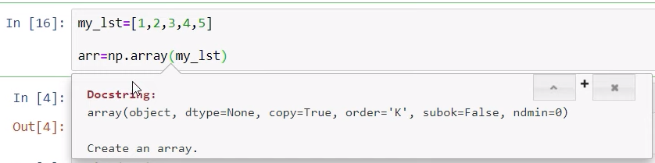
Array
1D Array
How to identify : Since one square brackets
My_lst = [1, 2, 3, 4, 5]

Slide 3
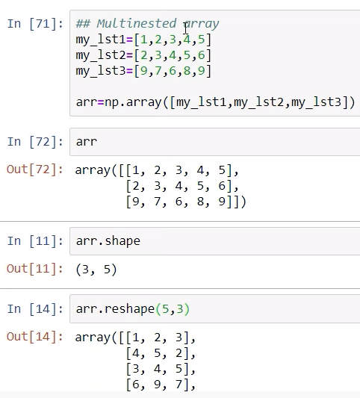
2D Array
How to identify : Since two square brackets
array([[1, 2, 3, 4, 5],
[2, 3, 4, 5, 6],
[9, 7, 6, 8, 9]])

Slide 4
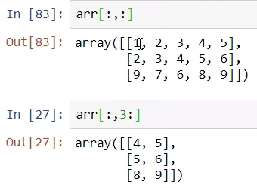
Arr[ , ] ----- first put comma
Arr[Row index, Column index]
Arr[ : , : ]
All the Column indexes
All the Row indexes

Slide 5
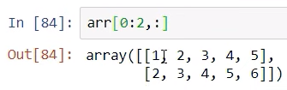
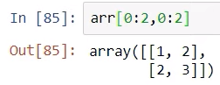
Arr[0:2, : ]
Arr[0:2,0:2 ]
First & Second Row
First & Second Columns
First & Second Rows

Slide 6
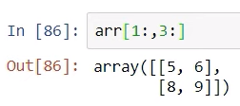
Arr[1: ,3: ]
print(arr[1:,2:4])
print(arr[1:2,1:4])
First & Second Columns
First & Second Rows
# pick up 4,5,6,8
arr[1:, 2:4 ]
# pick up 3,4,5
arr[ 1:2, 1:4 ]
arr[1: ,2:-1]
arr[1:2,1:4]
arr[1:4,2:4]
arr[1:2,1:4]

Slide 7
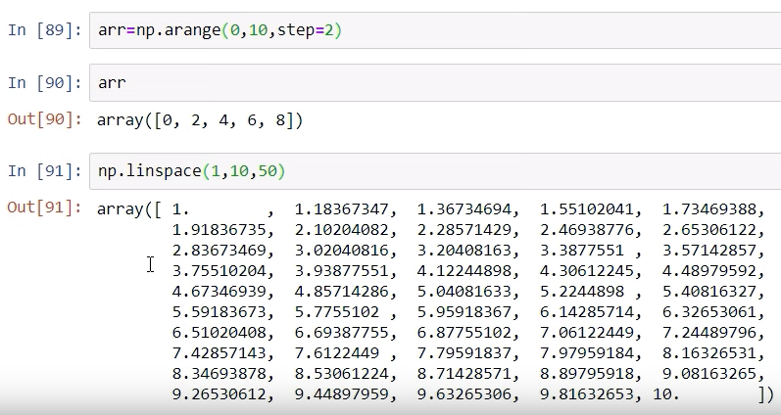
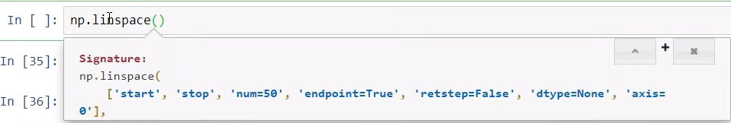
Between start & stop values how many points required. Equally divided points. In deep learning very useful.

Slide 8
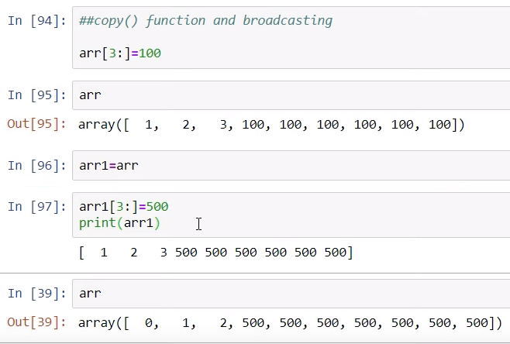
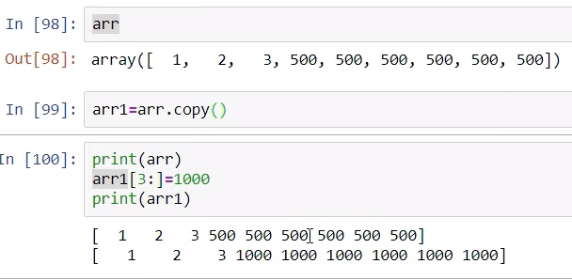
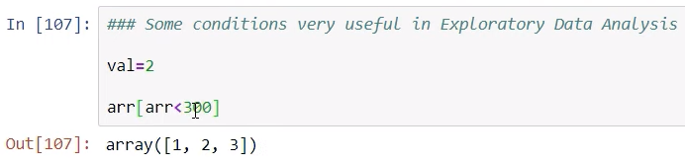

Slide 9
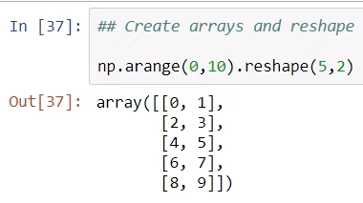

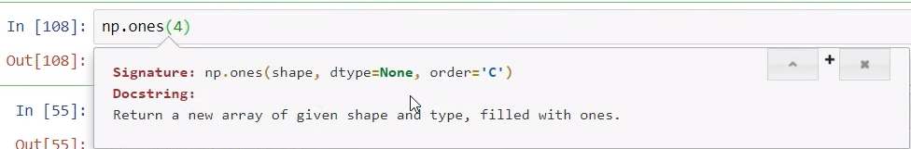
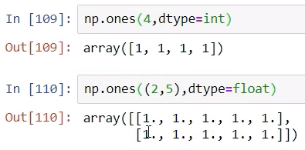

Slide 10
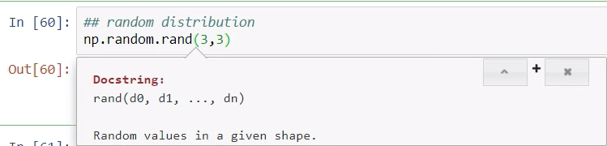
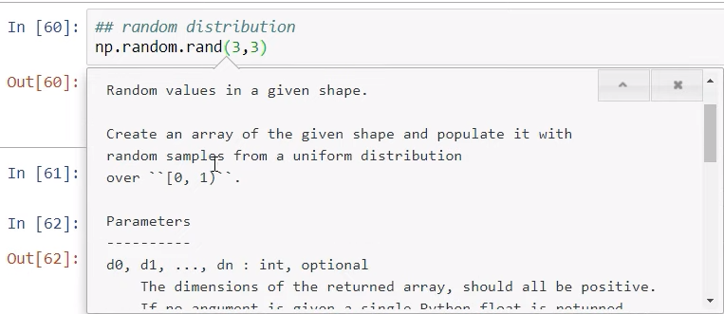

Slide 11
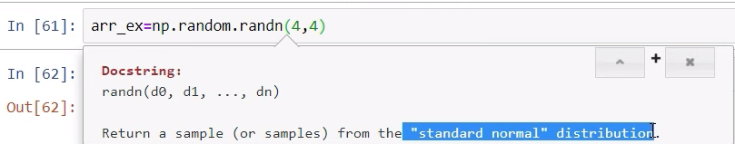
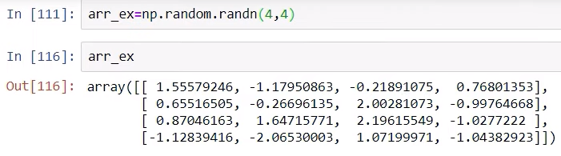

Slide 12
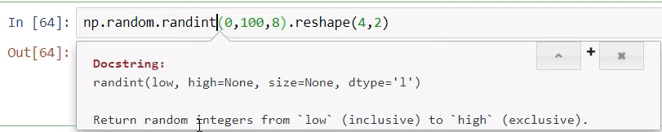

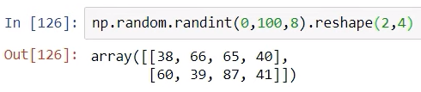

Slide 13
